Slide 1
Unit 1: Connections
Caroline Simon

Slide 2
You never get a second chance to make a first impression…
20 seconds?
Public speakers?
Ex 2 p4: Read article: Do you agree?
Ex 2 p4: Article: underline linking words
e.g. Many people fear public speaking, however, the more you practise, the more confident you get.

Slide 3
Reading ex 2 p4
Match words from the text with the following definitions
Continue to believe something
Make a mistake or spoil a situation
To find interesting / unusual / impressive
Connection with /membership of an organisation
Not making you feel interested or excited
It is not surprising
She caputered our attention
To deserve and get (e.g. respect)

Slide 4
Reading ex 2 p4
Match words from the text with the following definitions
Continue to believe something
Hold on to something
Make a mistake or spoil a situation
Mess up
To find interesting / unusual / impressive
Be struck by
Connection with /membership of an organisation
Affiliation
Not making you feel interested or excited
Uninspiring
It is not surprising
No wonder
She had us
She captured our attention
To deserve and get (e.g. respect)
Command

Slide 5
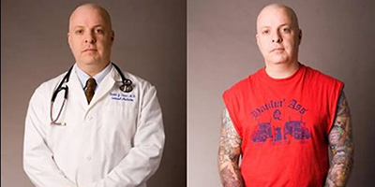
Getting it right
Ex 5 p5: Listen and match (read quotes ex 4)
Ex 6 p5: Listen and complete

Slide 6
Tense Overview
Simple Present
Present Continuous
Simple Past
Past Continuous
(Simple) Present Perfect
Present Perfect Continuous
(Simple) Past Perfect
Past Perfect Continuous
Simple Future
Future Continuous
(Simple) Future Perfect
Future perfect continuous

Slide 7
Grammar: Ex 7-8 p5
PRESENT PAST WILL FUTURE
SIMPLE do you know (4) did … meet (1) will be (6)
means (4)
CONTINUOUS am reading (7) was teaching (2) will be heading (d)
PERFECT have believed (5) had met (3) will have finished (e)
PERFECT have been working (c) had been entertaining (b) will have been going out (a) CONTINUOUS

Slide 8
Tense Overview
Simple Present I work
Present Continuous I am working
Simple Past I worked
Past Continuous I was working
(Simple) Present Perfect I have worked
Present Perfect Continuous I have been working
(Simple) Past Perfect I had worked
Past Perfect Continuous I had been working
Simple Future I will work
Future Continuous I will be working
(Simple) Future Perfect I will have worked
Future perfect continuous I will have been working

Slide 9
Tense Overview
Ex 8 p5: Match the sentence halves
Ex 9 p5: Explain the difference

Slide 10
Tenses @ home
Try the introductory tests in ACE
Practise and report when you get stuck
Deadline: week 10

Slide 11
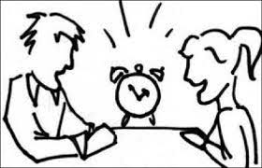
Question Forms
Speed dating?
Speed business networking?
Ex 2 p6: Read the text
Could this work?
Ex 6 p6: Listen and complete
Ex 9 p7: Make questions + match with answers

Slide 12
Question Forms
Ex 10 p7: Pair quiz 1
(as FEW questions as possible)
student A = File 1, p114
student B = File 63, p126

Slide 13

Question Forms
Ex 11p7: Pair quiz 2 (as MANY questions as possible)
  ➔ 2 x 2’- interview

Slide 14
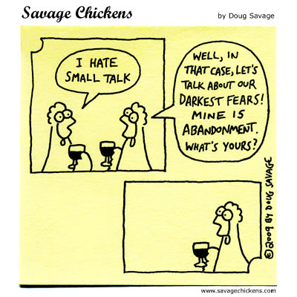
Developing Conversations
Small talk topics?
(in)appropriate?

Slide 15
It’s good to talk
Ex 2 p10: Listen
How does the second speaker sound each time? (box p10)
Ex 3 p10: Listen
Match the Q&A
Ex 6 p10: Listen
Which strategy from the table does the 3rd person use?

Slide 16
It’s good to talk
Ex 9 p11:
How can an active participant in a conversation encourage a quieter one to take part?
Ex 10 p11: Listen and complete
➔ involve the quieter person

Slide 17
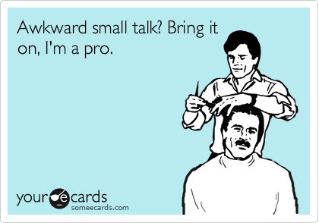
Count me in!
Ex 11 p11 Conversation starters: pair work
STUDENT A: pick one of the starters
STUDENT B: comment/ask follow-up question
➔ Take turns

Slide 18
The art of conversation
Ten conversation tips that work
= how to show interest / develop the conversation
➔ Exercise coursenotes p96: pick 1 topic each (2 x 3’)

Slide 19
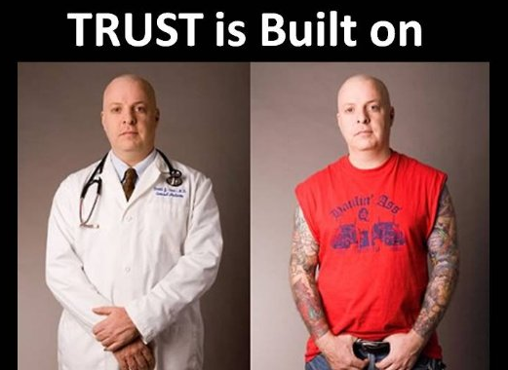
Making a good impression
What makes a good presentation?
What makes a first impression?

Slide 20
It’s not just what you say…
Ex 2 p12: Read article
Ex 4 p13: Rate the presentation
Ex 5 + 6 p13: Listen and complete the table

Slide 21
Planning a presentation
Select infographic
  90’
  Find an opener that will make an impact
  Think of strong conclusion
  Think about tone of voice / body language
  Group of 4:
  1 presenter
  1 timekeeper
  1 body language expert
  1 language expert
Switch roles!

